Slide 1
Outreach summary
V. Rosmorduc (CLS)
M. Srinivasan (JPL)

Slide 2
Session outlook
Few abstract submitted , but good response to the “outreach showcase” last minute call, so all in all, a number of interesting projects shown (thanks!)
From North & South America, Australia and Europe
Outreach & education as well as data services
A noticeable part on Swot (but not only)
Several presentation on “applications”

Slide 3
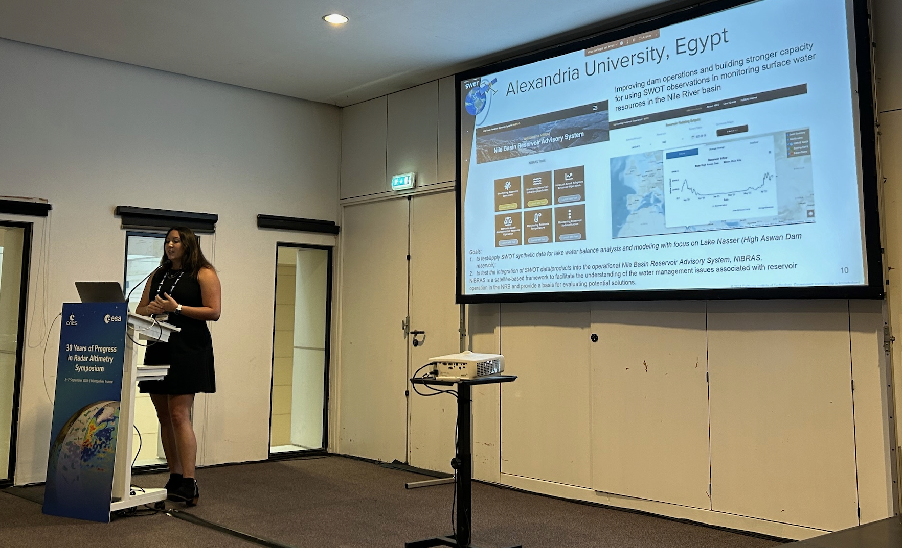
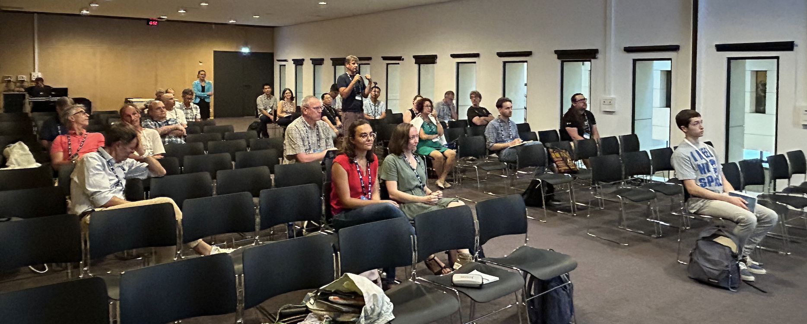
Session details
Talks
30 yrs of societal benefits from ocean altimetry mission data – M. Srinivasan (JPL)
Accelerating societal benefit of the surface water and ocean topography mission -- A. Rodriguez et al. (JPL)
Promoting & explaining a new technology: Swot outreach – V. Rosmorduc et al. (CLS)
The horizon2020 open cloud for research environment project's high-resolution – S. Ponce de León Alvarez et al. (Centec)
Outreach showcase:
“I had a storm” – F. Ardhuin (Ifremer)
CTOH product poster – F. Blarel (CTOH)
What’s new on Aviso – C. Germineaud (Cnes)
Chalmers’s MOOC – K. Le Bail (Chalmers Univ.)
IMOS-OceanCurrent: Up-to-date ocean information around Australia - G. Pilo (CSIRO)
Argonautica, what’s new for 2014-25 – E. Raynal (Cnes)
Outreach at the Department of Oceanographic and Atmospheric Sciences University of Buenos Aires, Argentina, L. Ruiz Etcheverry (Univ. Buenos Aires)
Posters:
Expanding the use of Copernicus marine altimetry data: EUMETSAT user support and training activities – B. Loveday for Eumetsat
CTOH products to extend the range of altimetry applications over the ocean and contiental surfaces – F. Blarel (CTOH)
OpenADB: DGFI-TUM's Open Altimeter Database – C. Schwatke (TUM)

Slide 4
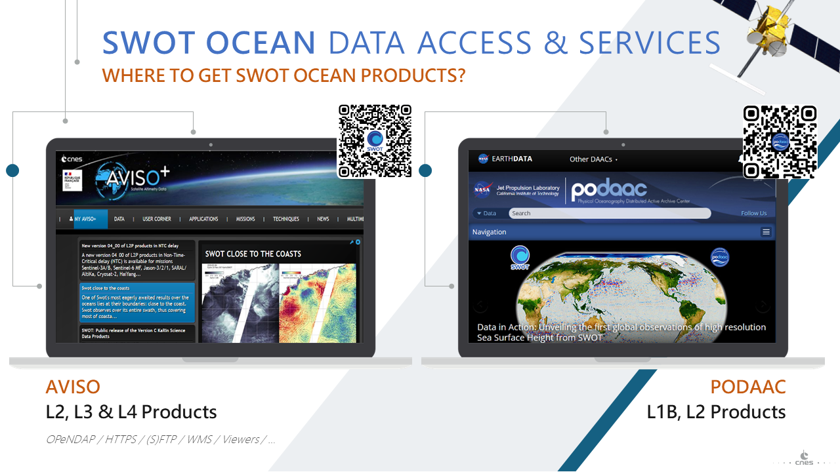
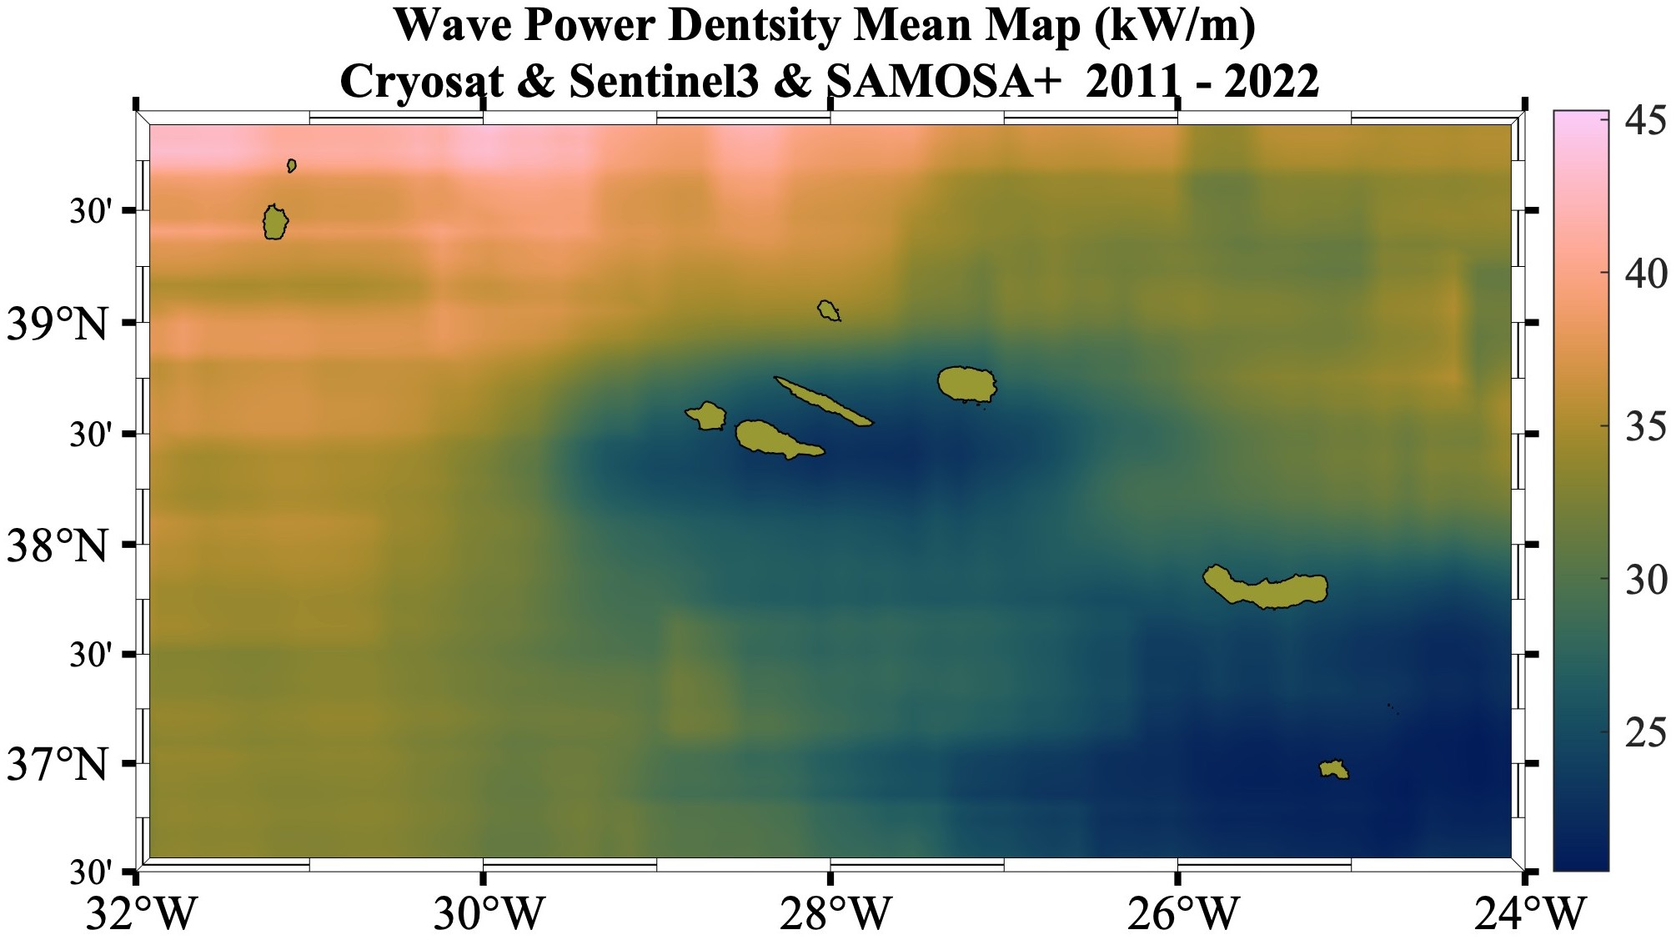
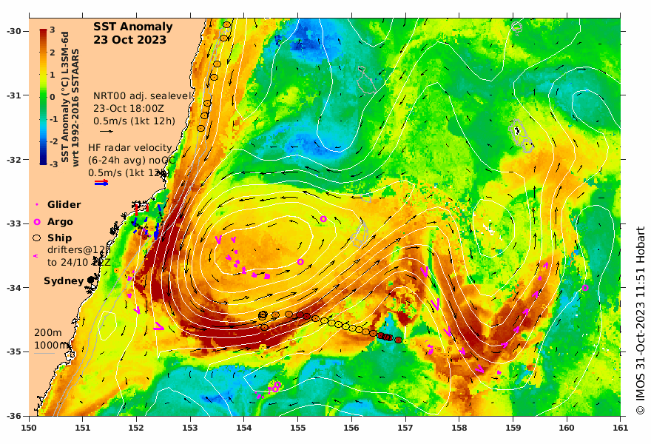
Data Services
Swot is requiring a new approach,
Previous data & services still need to be available – and to be upgraded
Thematic-dedicated products
(aiming at mid or end-users)

Slide 5
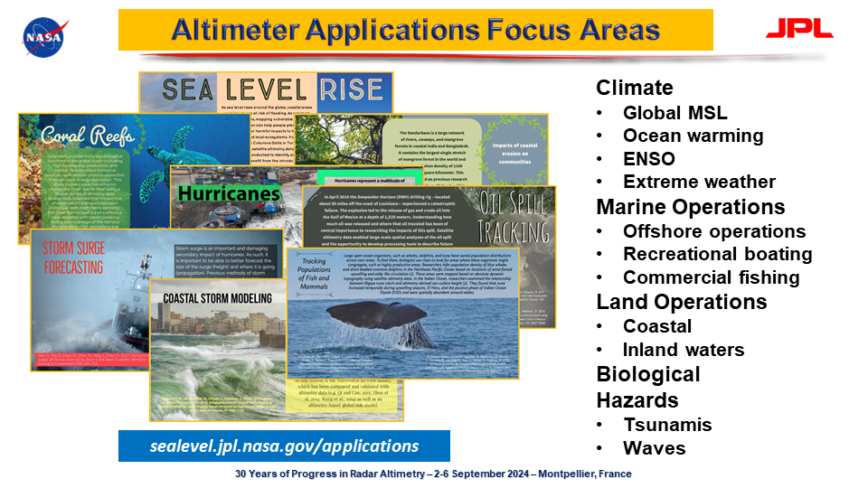
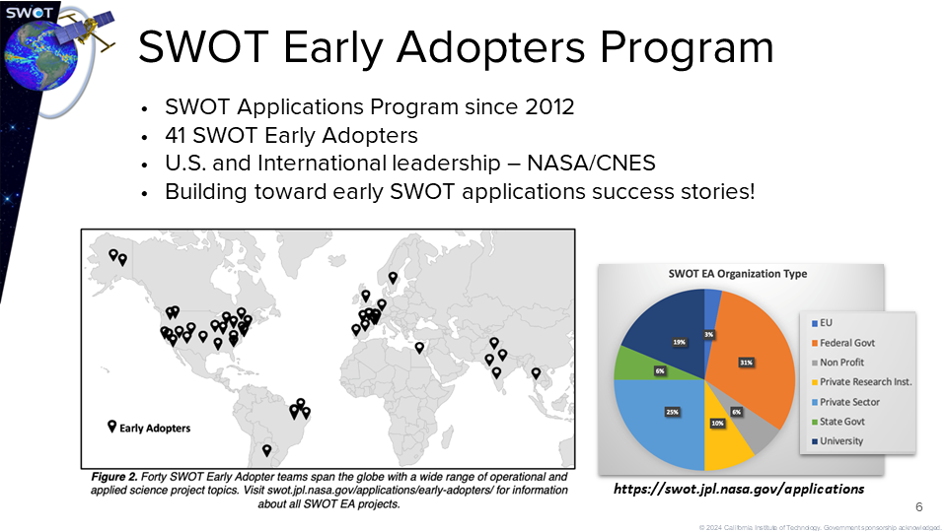
Societal benefits
JPL Programs dedicated to promoting and helping to advance use of altimetry for practical uses
Swot early adopters (in partnership with Cnes – regular meetings, hackathons, resources)
30 yrs from altimetry data (talks in conferences brochure & web pages)

Slide 6
Trainings
Teaching oriented towards users / would-be users
Mostly online nowadays
Both theory & practicals
When in person, often in the frame of a science meeting
(e.g.; Saturday’s training)
Wider announcements?
Radar Altimetry Tutorial update?

Slide 7
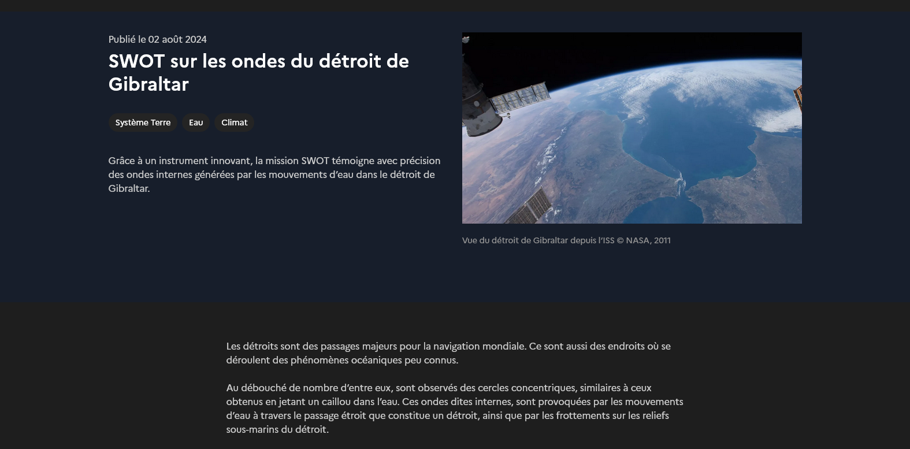
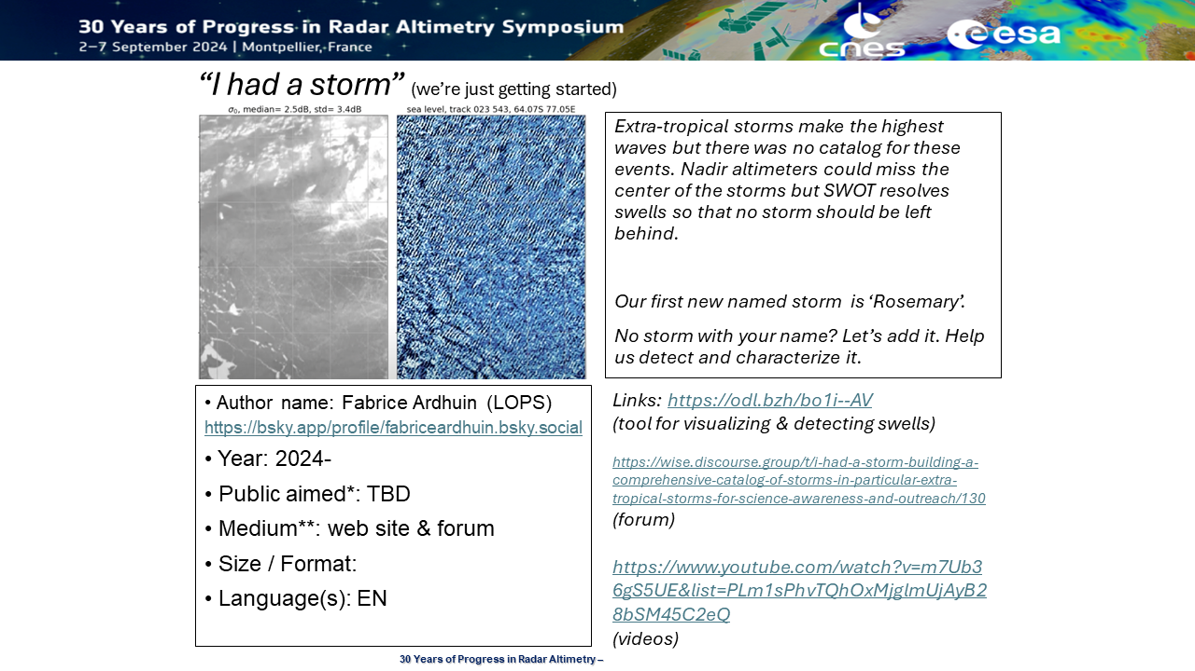
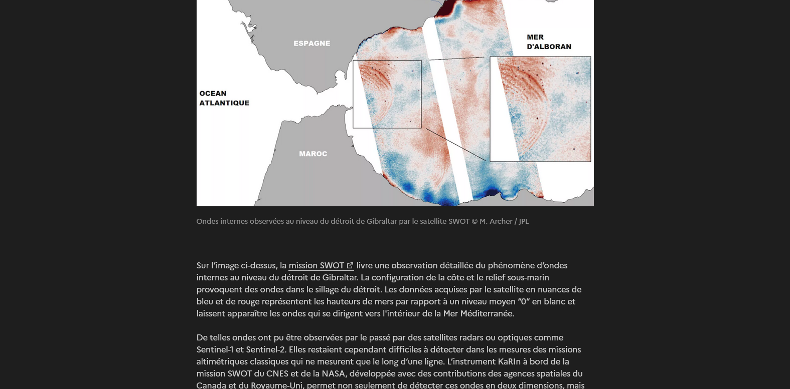
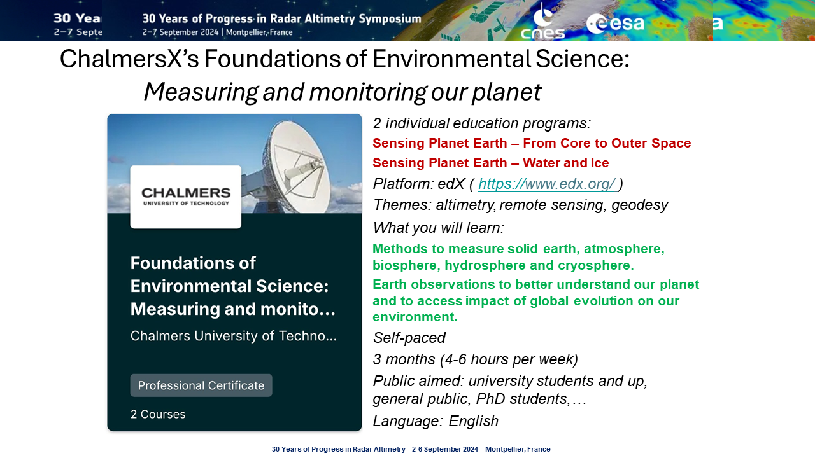
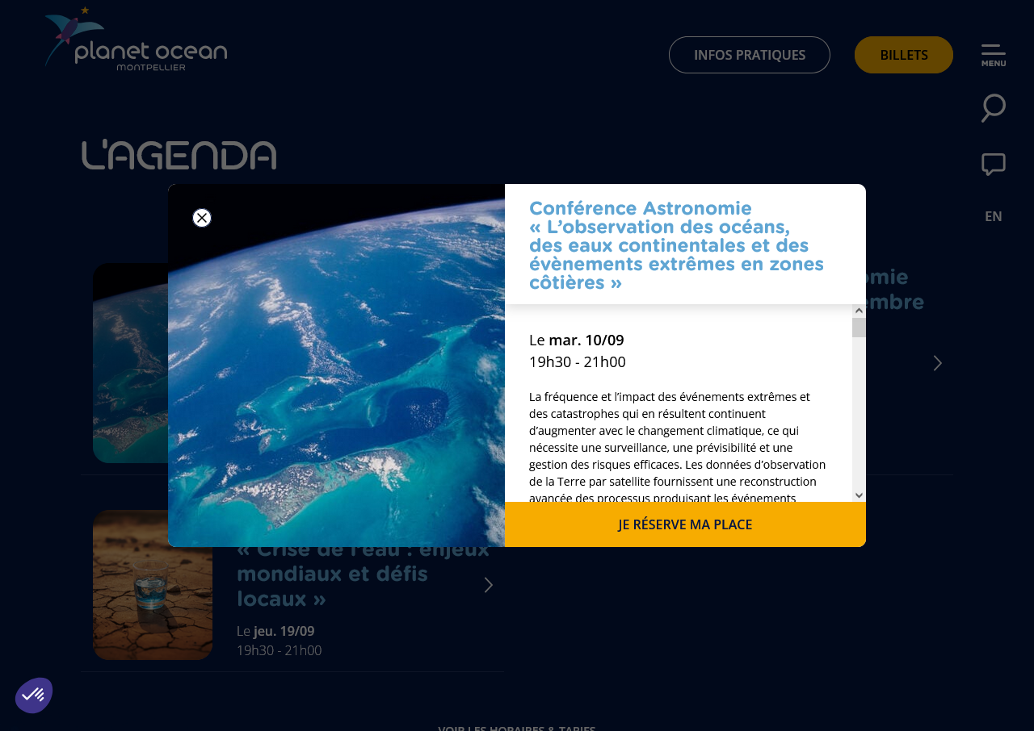
Outreach
Material on Swot on Aviso & Cnes web sites
Citizen science ‘I had a storm’ (locate a storm from its swell, and name it) – see Fabrice Ardhuin
Lecture on Swot at Toulouse Space Museum (D. Leroux & R. Morrow)
Lecture on Sept. 10 in Planet Ocean, Montpellier by J. Benveniste
Outreaching on Imos data service from actual maps/results or events
Mooc at Chalmers University on remote sensing, aiming at general public
…

Slide 8
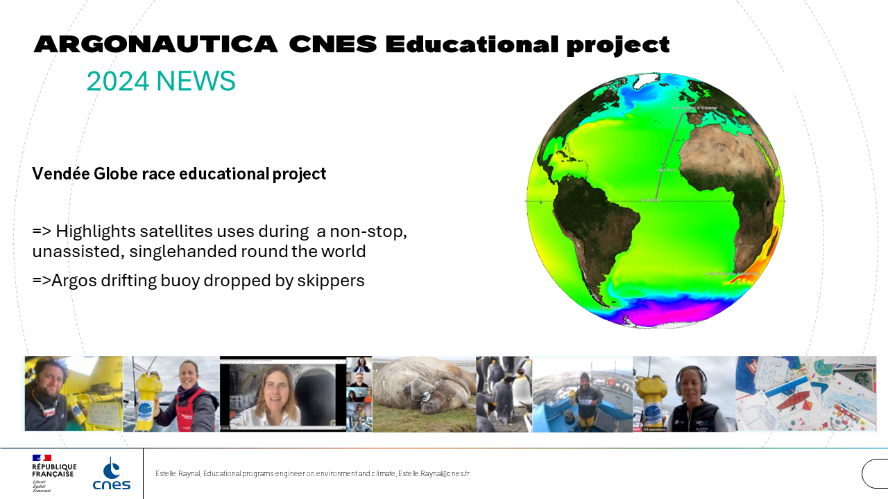
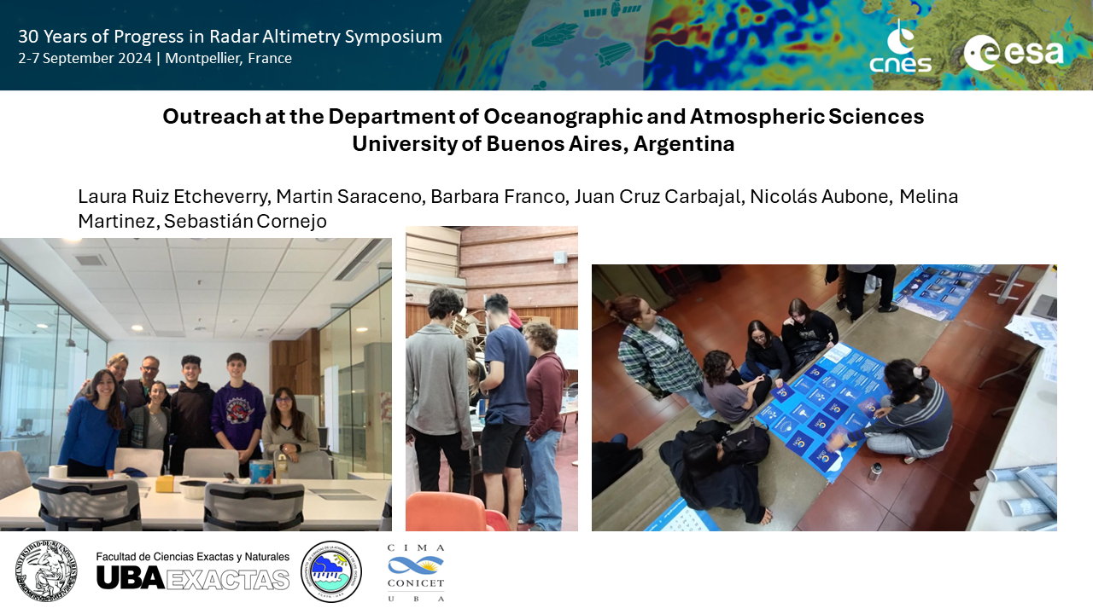
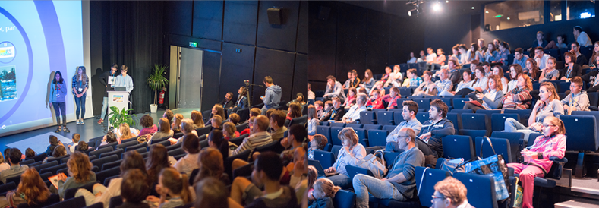
Education
University of Buenos Aires, Argentina inviting high school students in their lab, proposing hands-on
Argonautica program (Cnes, France)
(data platform in both English & French)

Slide 9
Thoughts & questions from this week
Can you share success stories / good examples of social media outreaching in altimetry field (broadly)? Successful media/format you’ve experimented?
Feedback needed on existing material / activities (what do you really use, what is missing, what would you prefer differently?)
Ways of sharing & publicizing trainings events or resources in the altimetry community?
Presentations on a “what became of them?” line – previously shown tools, activities… N years after, for feedback, lessons learnt etc. would be of interest
What kind of outreach activity you would be ready to participate to? (or already do)
Some posters presented this week verged on outreach, being synthetic & illustrated. At least one author even did poems on altimetry.

Slide 10
Recommendations / Future outlook
Data services: content & user experience crucial, but the possibility of finding them in Search engines is also important
Do not hesitate to notify us of activities you’re engaged in, and/or ask for slides or figures (they might not exist, but they may, or may be created)
Develop or continue trainings (both interactive & self-paced; sometimes in person if possible)
Proposing volunteer attendees to work on an outreach output from such meeting? (general-public oriented poster, rapid fire poetry (“slam battle”), “my poster in 180s” / elevator speech…?)
A kind of training in outreach during meetings? Outreach report in plenary?...
and continue on presenting a lecture for general public / invite a science museum for a talk during the meeting

Slide 11
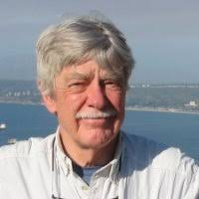
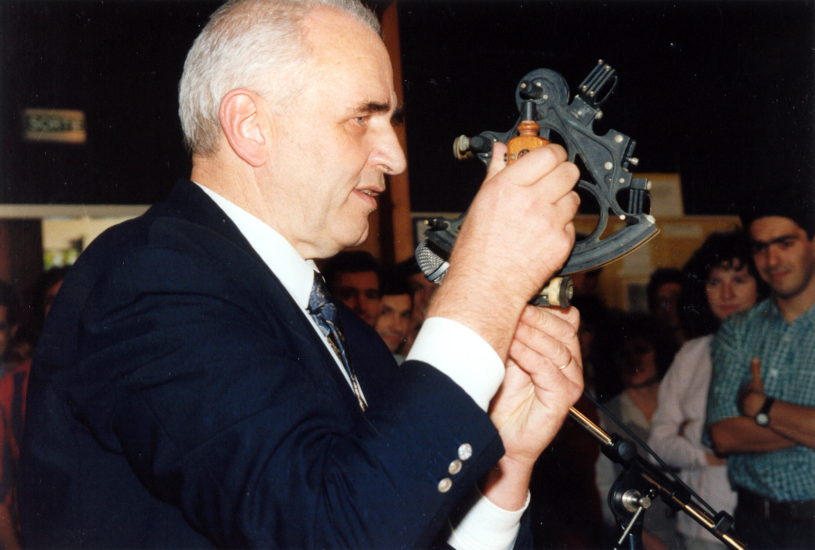
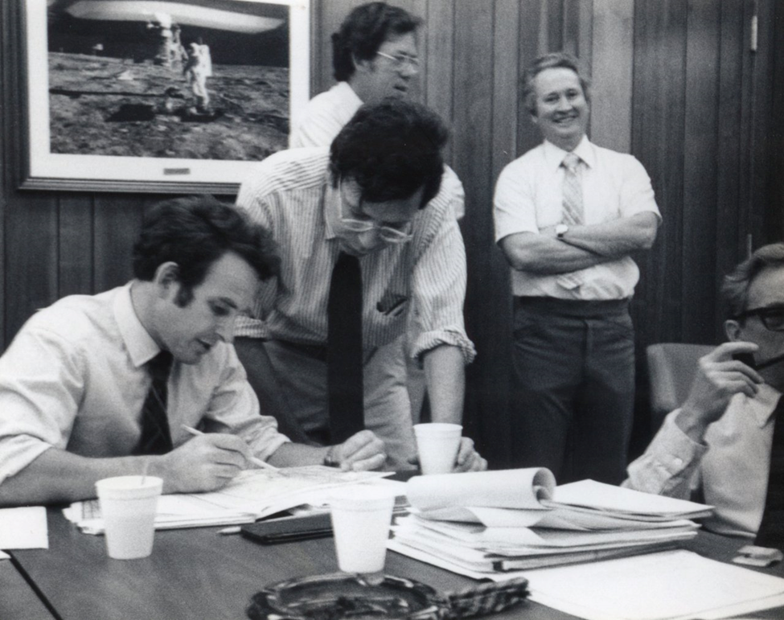
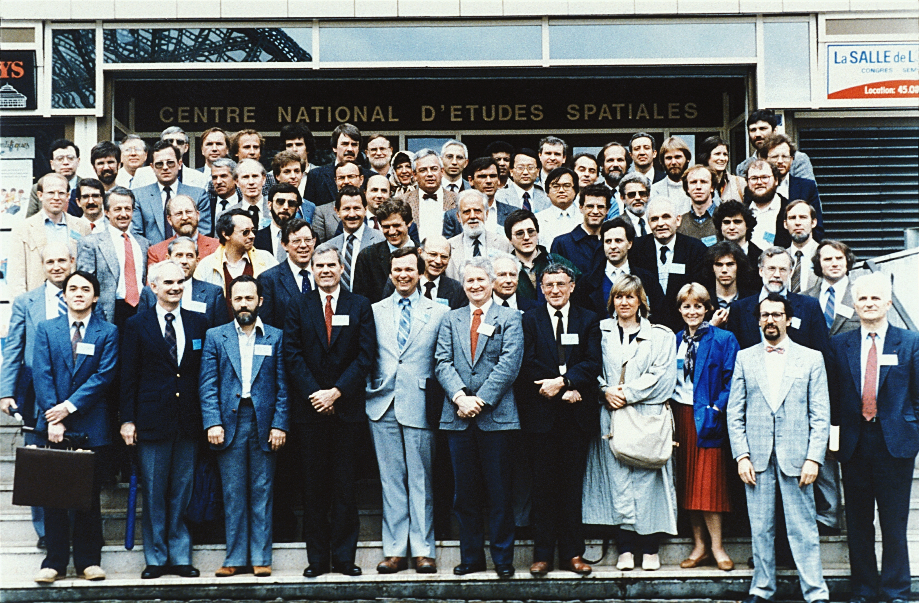
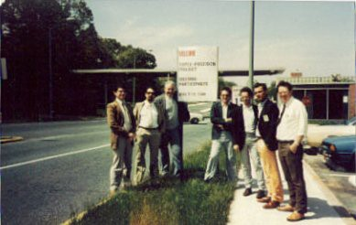
Call for contribution for material on history of altimetry
“Oldtimers” who participated to the beginnings are leaving
Altimetry is also a story of people and their implication, not “only” a question of physics of a radar wave and of bumps on the ocean!

Slide 12
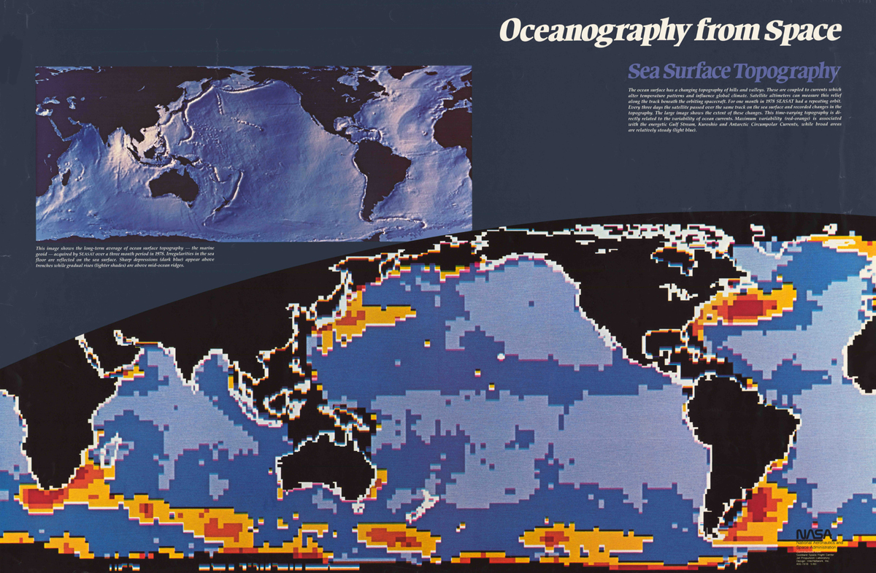
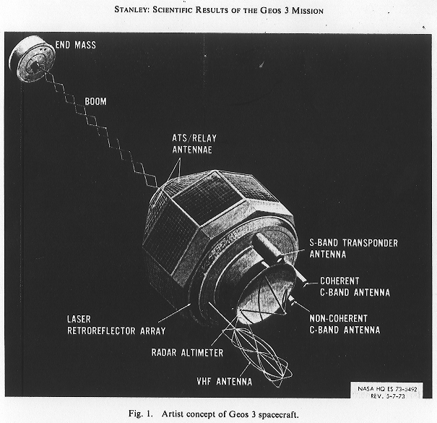
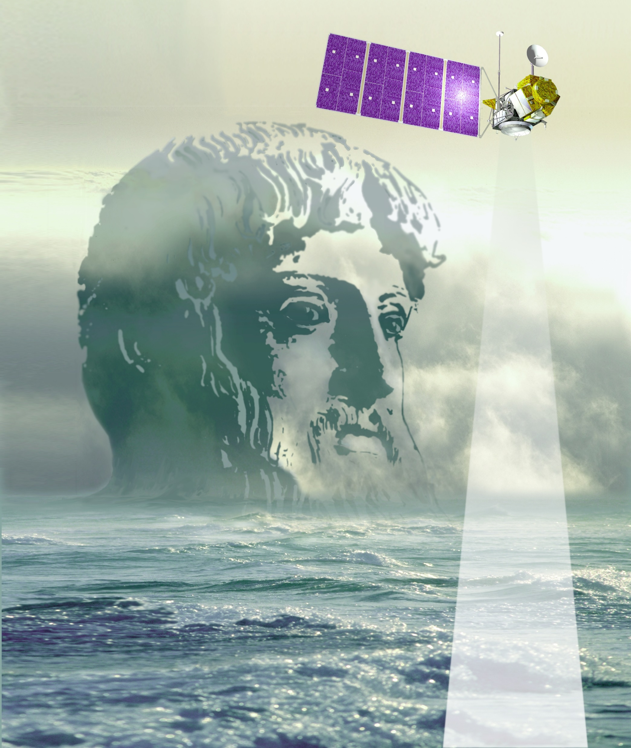
(Work in progress…)
series of slides on altimetry history:
  from in situ oceanography to Swot,
  mostly science & technique, institutional frame, project…
The people involved and the stories they are telling:
  format/medium still tentative:
  “portrait”+ one-two personal stories?
  material collected in part
If you have old photos, figures,
documents scan them and send them
to me (vrosmorduc@groupcls.com)
If you have stories, too

