Slide 1
Operational Oceanography Sessions
Summary of Recommendations
Sarah Gille¹
Deirdre Byrne²
¹University of California San Diego, Scripps Institution of Oceanography
²US NOAA, Center for Satellite Applications and Research, Laboratory for Satellite Altimetry

Slide 2
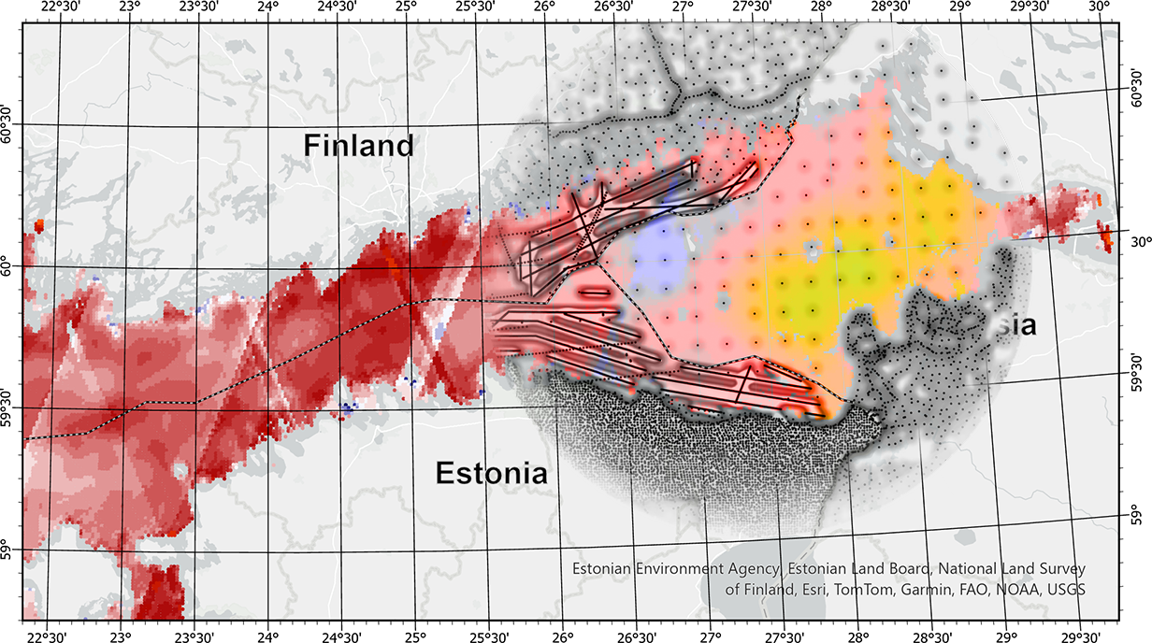
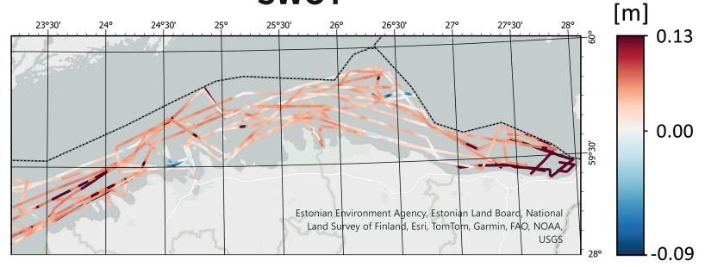
Kupavõh,Aª., Delpeche-Ellmann, N^{b}., Ellmann, Aª.
ª Department of Civil Engineering and Architecture, Tallinn University of Technology, Estonia
^{b} Department of Cybernetics, Tallinn University of Technology, Estonia
Due to high coverage and resolution of KaRIn data we managed to quantify BSCD2000 modelling errors in previously inaccessible area (due to country boundaries).
Mean = 6.2 cm
Shipborne GNSS and ALS data used for geoid modelling was also used to assess KaRIn-derived geoidal heights.
SD = 4.5 cm

Slide 3
SO FAR, NO IMPROVEMENT TO SKILL OF NWP
Aikaterini Anesiadou
ECMWF colleagues:
Noureddine Semane, Philip Browne, Sebastien Massart, Saleh Abdalla Supervisors:
Sean Healy, Patricia de Rosnay (ECMWF) Mentor:
Jürgen Kusche (CESOC, University of Bonn)

Slide 4
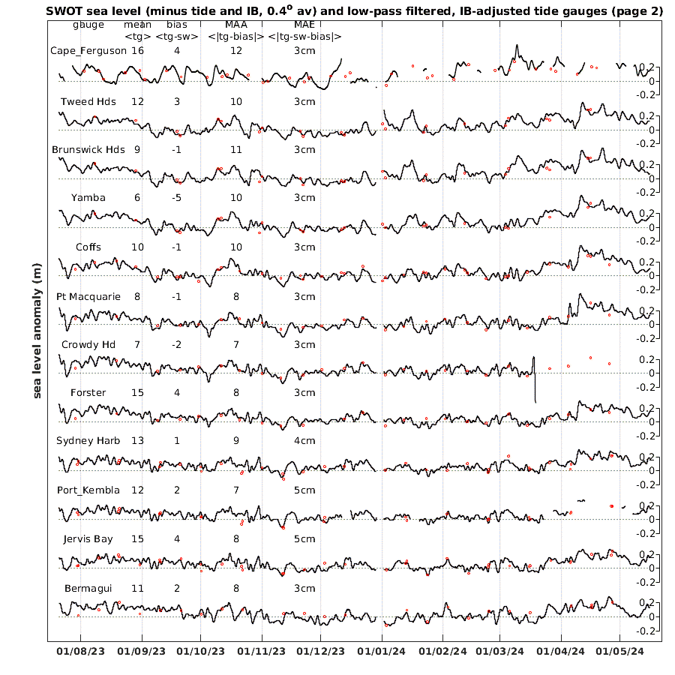
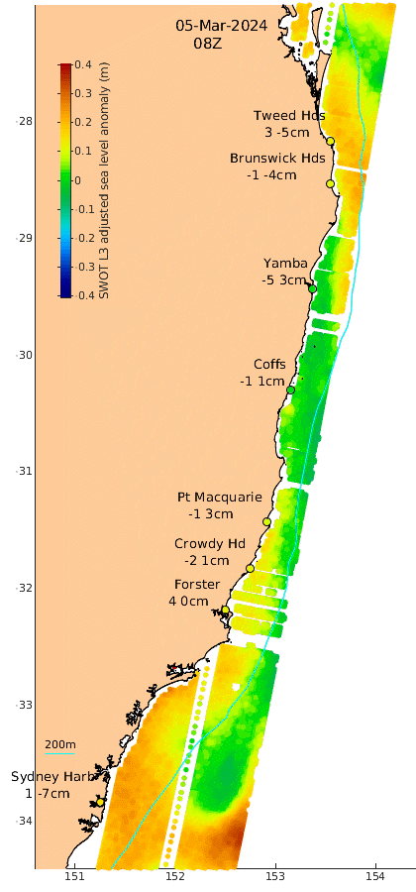
David Griffin, Madeleine Cahill, Gabi Semolini Pilo and Bernadette Sloyan
CSIRO Environment

Slide 5
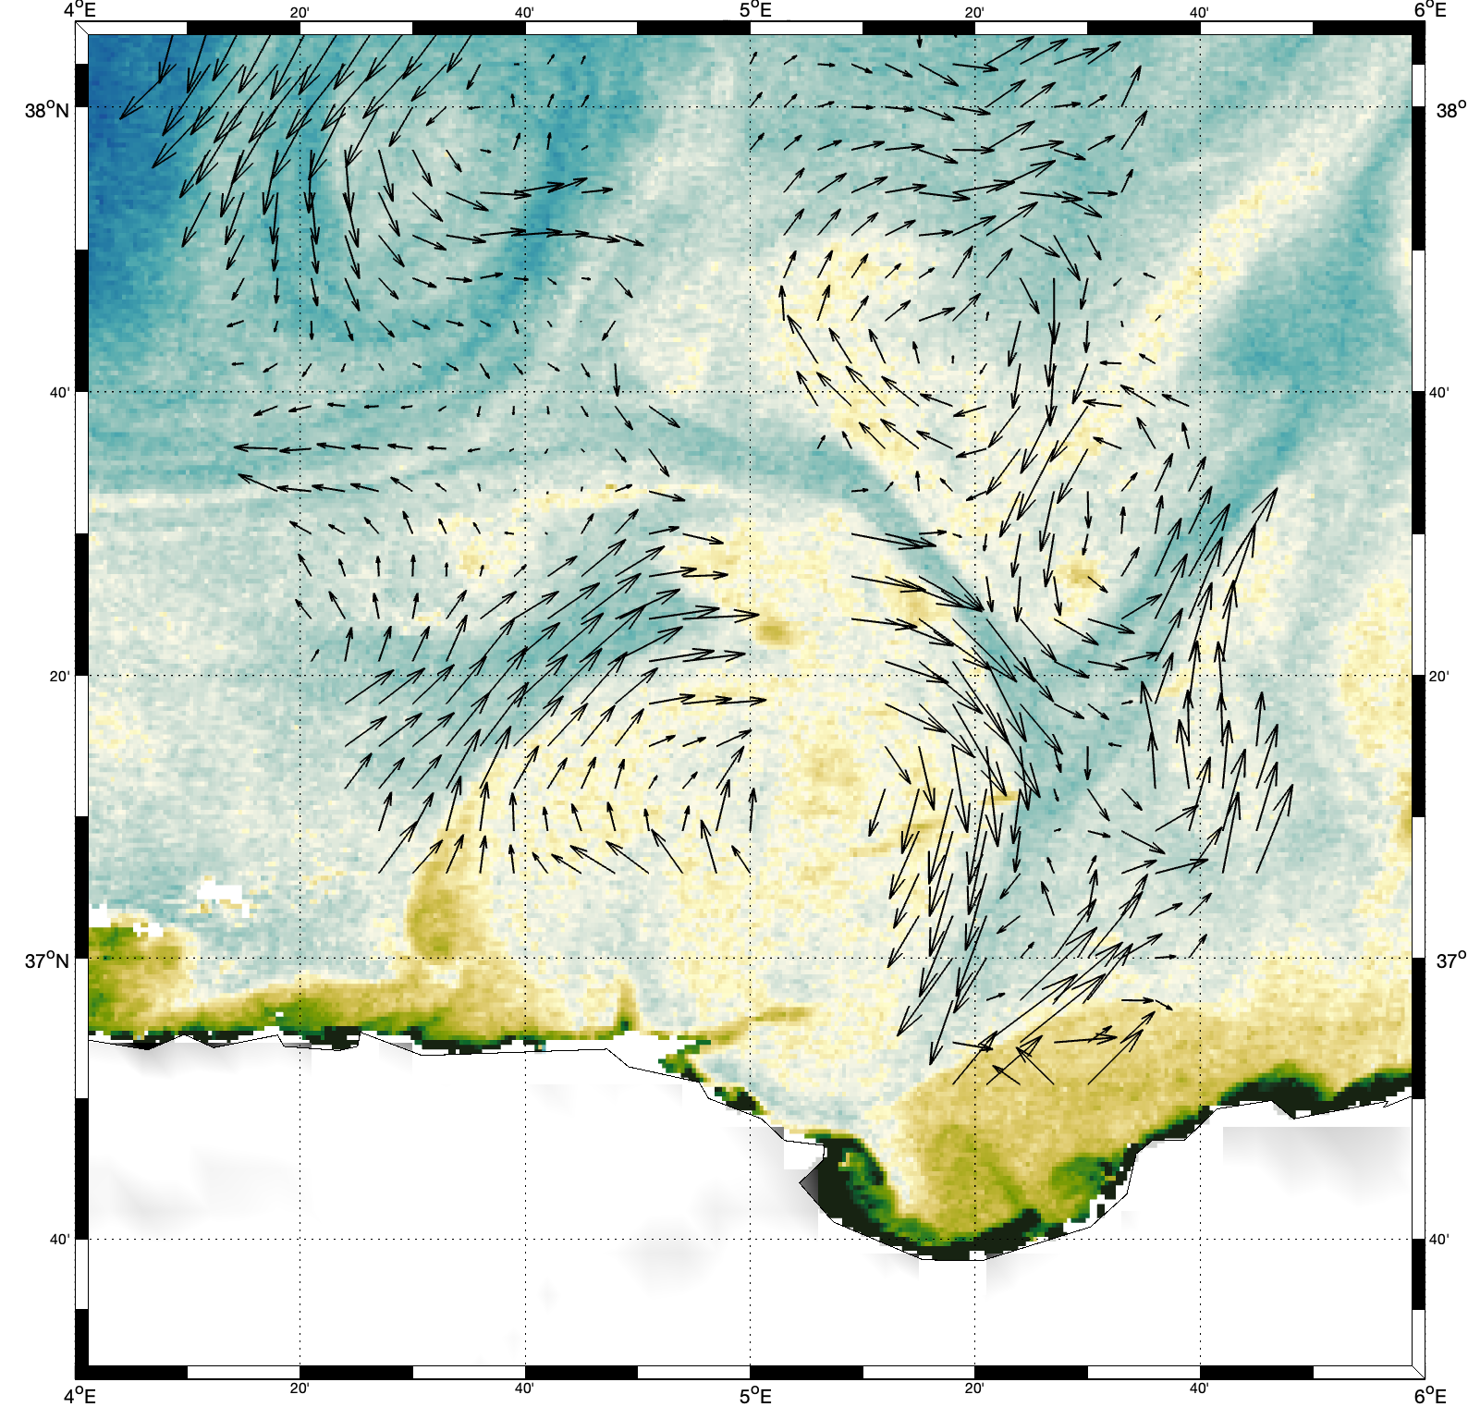
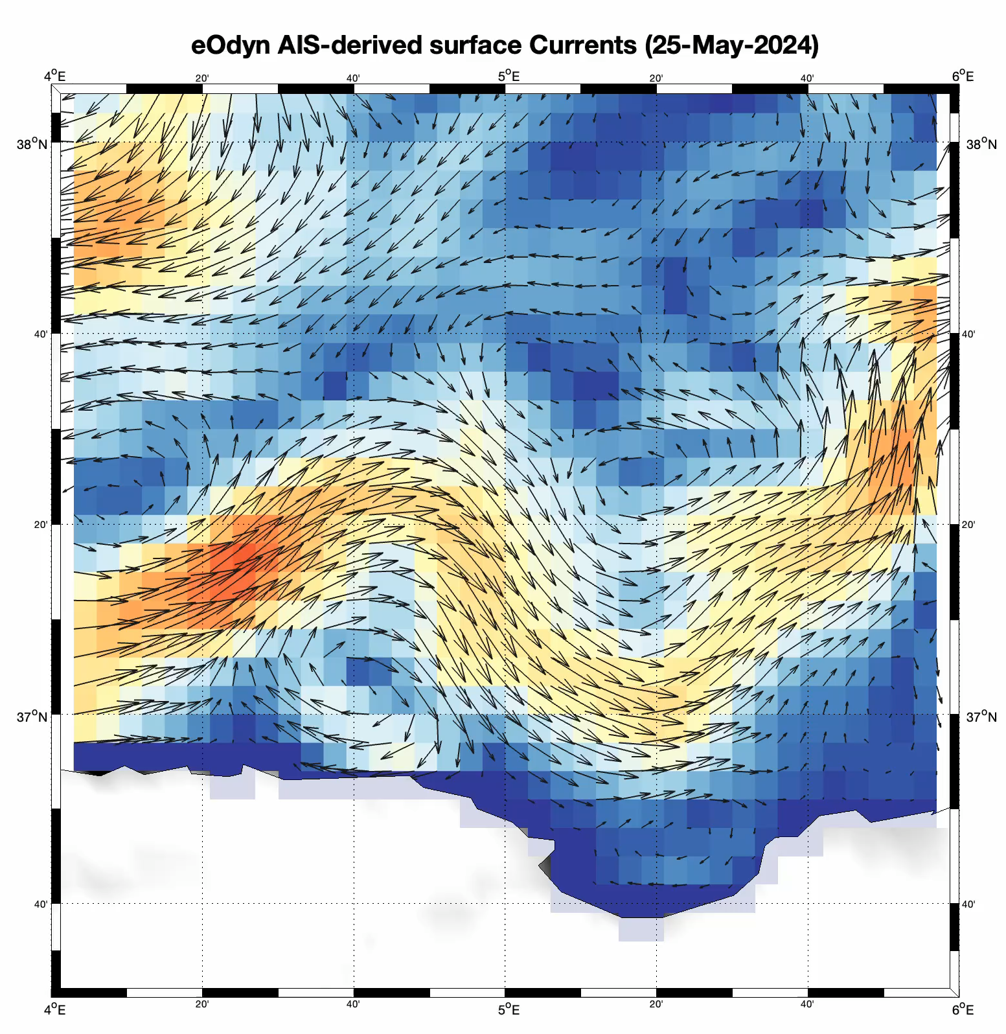
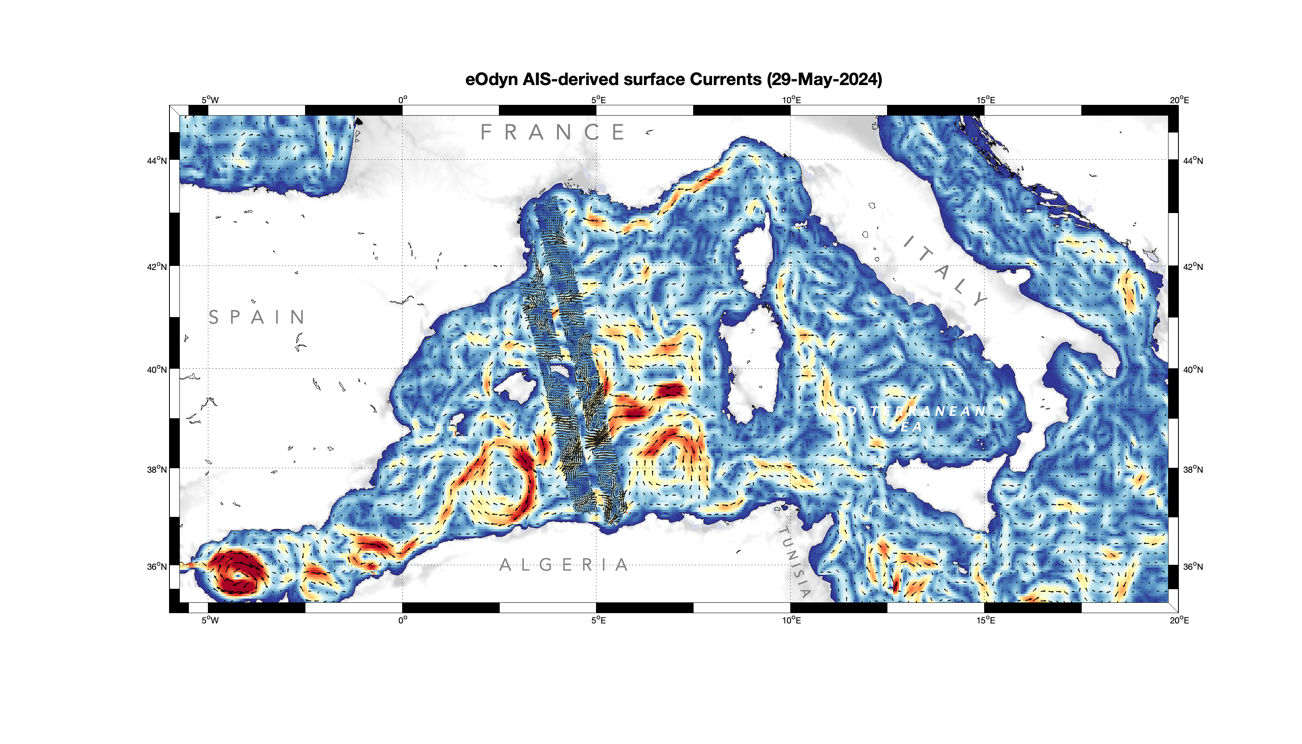
Submesoscale eddies analysis
29 May 2024
30YPRA Symposium – Yann Guichoux and eOdyn team
04/09/2024
SWOT Ocean Currents
+ OLCI sentinel CHL-A
(downsampled vectors)
AIS-based product (3 day composite)

Slide 6
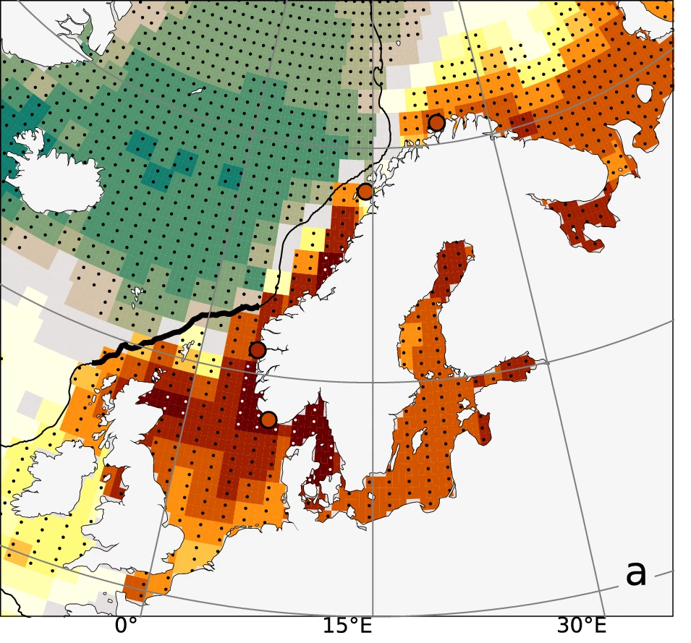
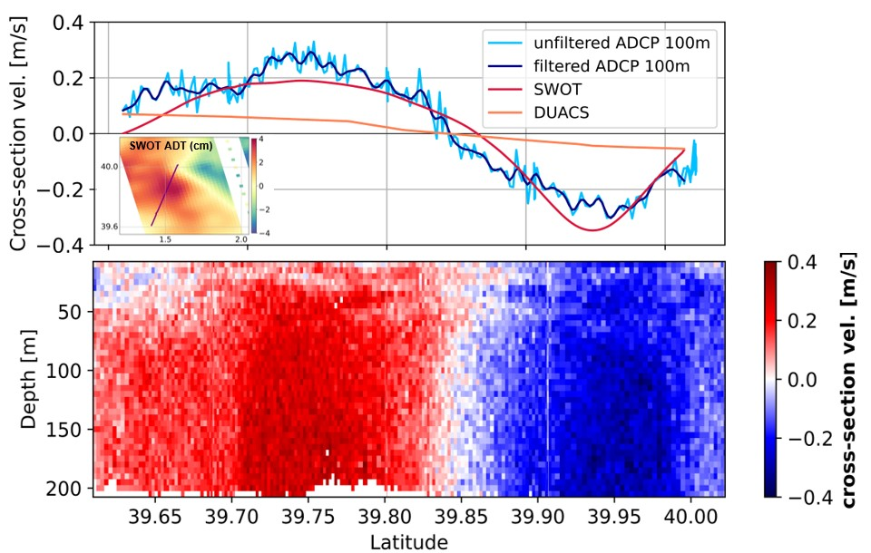
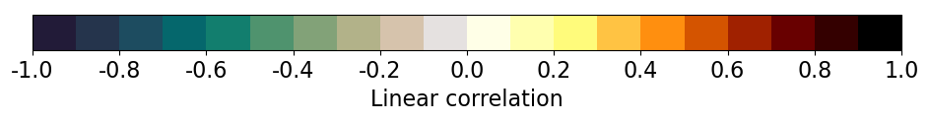
L. Gómez-Navarro, E. Verger-Miralles, B. Barceló-Llull, B. Casas, N. Calafat, V. Combes, E. Cutolo, L. Diaz-Barroso, M. Garcia-Jove, I. Lizarán, E. Reyes, D. R. Tarry, N. Zarokanellos, B. Mourre and A. Pascual
Fabio Mangini
Antonio Bonaduce | Nansen Environmental and Remote Sensing Center, Norway
Mediterranean SWOT-derived velocities correlate very well with LADCP at 100 m depth
ALES-GRACE Correlation

Slide 7
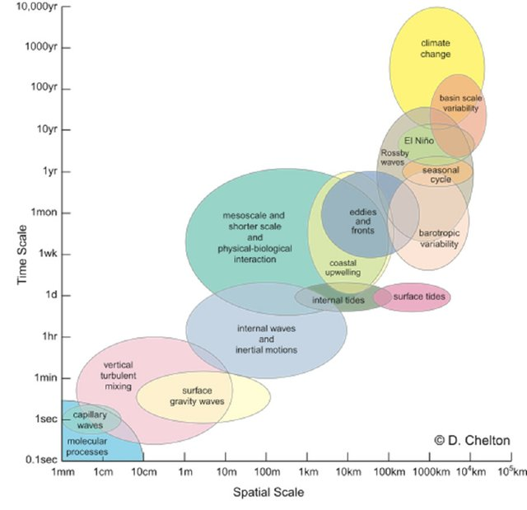
The SWOT Challenge
Sarah T Gille, Ariane Verdy, Matthew R Mazloff, Bruce D Cornuelle, Ganesh Gopalakrishnan, Manuel Othon Gutierrez-Villanueva and Saulo M Soares
sgille@ucsd.edu
Scripps Institution of Oceanography, UC San Diego
Balanced geostrophic motions:
Linear processes
Unbalanced ageostrophic motions:
Nonlinear processes
Large-scale variability occurs over long time scales.
Small spatial scales have short temporal scales
SWOT
Nadir altimetry
How do we take advantage of SWOT’s spatial resolution, without corresponding temporal resolution?
Today: Using data to constrain dynamics
30 years of progress in 4dVar assimilation of radar altimetry
Pursuing small scales and rapid variations for SWOT
SWOT
1-day

Slide 8
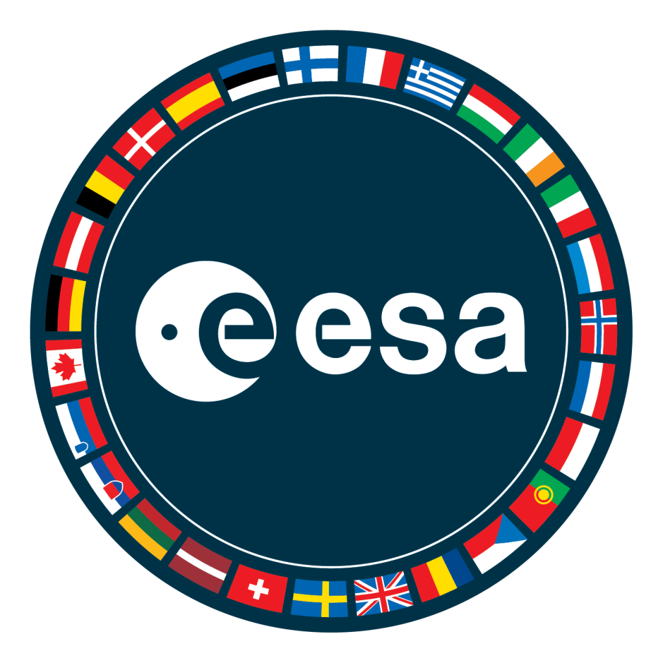
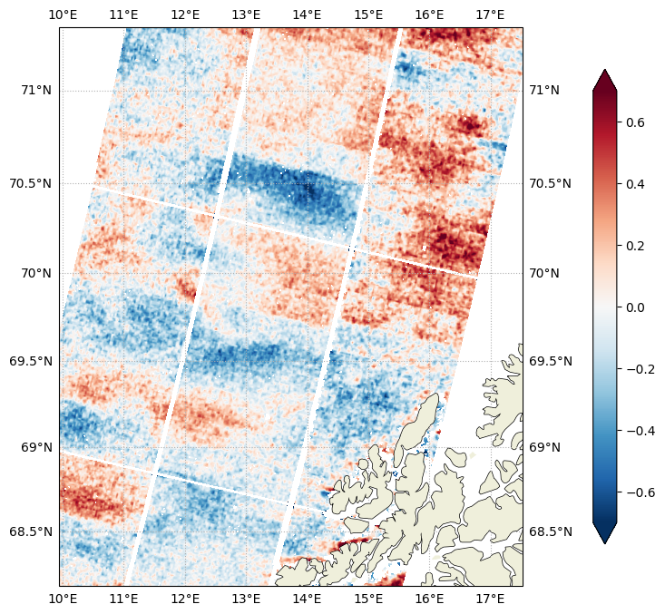
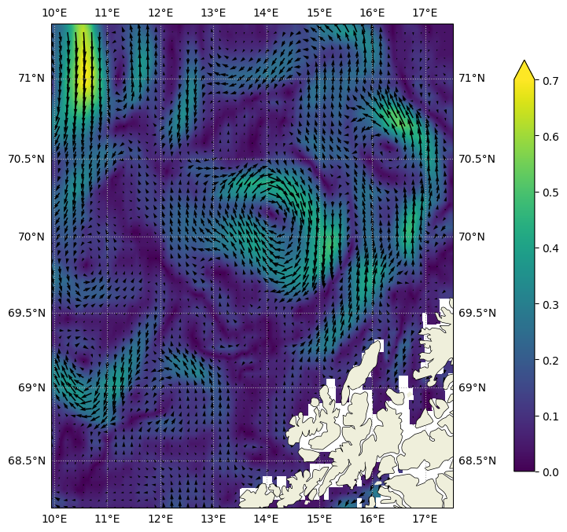
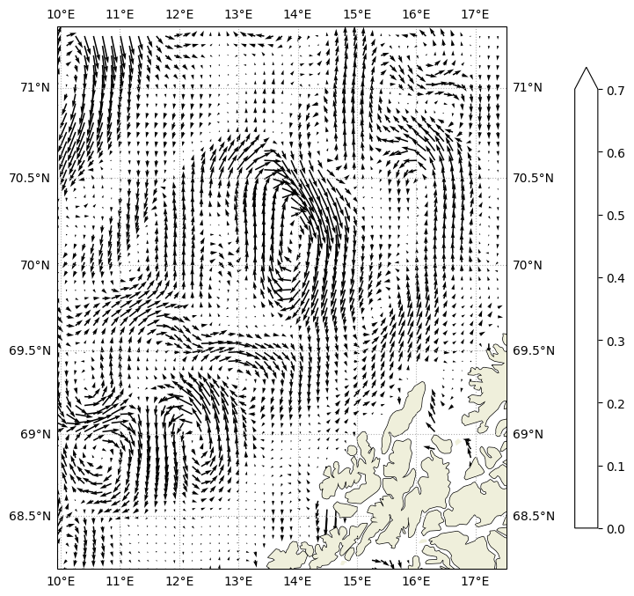
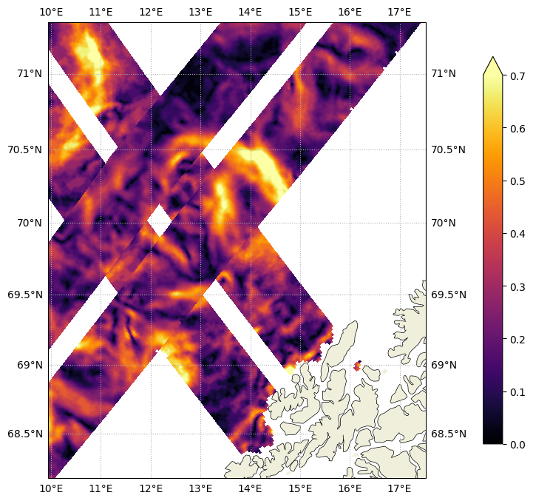
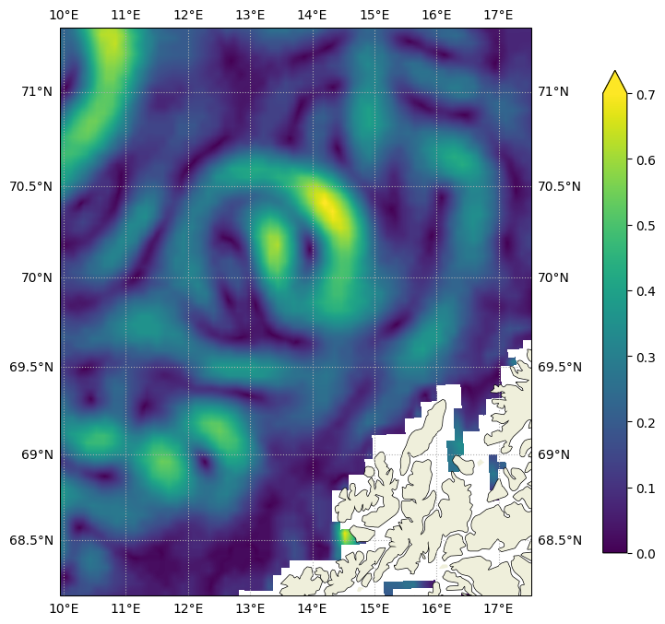
Ocean Surface Circulation in Lofoten Basin on 29th July 2023
From Sentinel-1 Doppler, SWOT, QG L4 current, and Mercator 1/12 – science phase
[m/s]
Input Data:
Mercator 1/12 surface current [8 km px s]
VarDyn Currents from combination of SWOT and nadir altimeters [5 km px s]
Geostrophic Current from SWOT [2 km px s]
Total Surface Current Radial Velocity from Sentinel-1 Doppler [1 km px s]
S1 Doppler, OSC RVL in m/s
[m/s]
VarDyn L4, geostrophic current in m/s
SWOT L3, geostrophic current
Mercator 1/12, surface current in m/s
Key points:
Good consistency between all products for features >> 30 km in terms of location (given time separation), magnitude, and direction
Small scale features (~10km) are not represented in the reconstruction but appear consistent between SWOT and Sentinel-1
A. Bonaduce¹, A. Moiseev¹, R.P. Raj¹, L.P. Moner^{1,*},
M. Babiker¹, J.A. Johannessen¹, F. Le Guillou²
¹ Nansen Environmental and Remote Sensing Center, Bergen, Norway
² ESA-ESRIN, Frascati, Italy
* now at: University of Trømso, Norway

Slide 9
Operational oceanography has found more maritime applications than we imagined - too many to try and list today. – David Griffin
Missions should be defined with operational uses firmly in mind / built into the mission design (the orbit, the temporal resolution of repeat measurements, the availability and reliability of data close to the coast) and latency requirements. Altimetry can make (further) useful contributions to:
  Coastal and high seas shipping
  Harmful Algal blooms
  Plastic pollution (advection, convergence)
  Coastal inundation
  The prediction of rapid intensification and sustainment of tropical cyclones near landfall
  Marine renewable energy (wave and current power generation)
  … the list is too long to fully enumerate here
The space agencies should be vocal in expressing the need for the continuation and improvement of in situ observation networks: e.g., Argo, Euro-Argo, NorArgo. These provide not only validation but important synergies.
Analysis and assimilation efforts benefit from commensurate spatial and temporal sampling.

Slide 10
Operational oceanography has found more maritime applications than we imagined - too many to try and list today. – David Griffin
We need altimetry to push into challenging areas, e.g. where the observing capabilities (both remote-sensing and in situ) are limited. SWOT-like altimetry is particularly valuable.
We need more / better high-resolution coverage in subpolar regions where the radius of deformation gets small.
GRACE is underutilized for coastal applications. More information can be extracted! GRACE data are surprisingly useful in some coastal regions.
Keep improving corrections (e.g., wet tropospheric, tides)! Different corrections should be considered and distributed to the community for evaluation, for SWOT and other new types of missions.
We must continue to foster engagement and training
Combining SWOT with other high resolution coastal data, e.g., HF radar, can help maximize its utility in operational marine applications such as marine traffic. This should be leveraged.
Operational oceanography should definitely continue to be supported.
Open Science is important. Require it as much as possible.
DEI / EDI is more than a catchphrase! It needs our active support. Every one of us.

Slide 11
What / where are our overlaps with operational hydrology? Other than latency, do we have common needs?
Operational oceanography has found more maritime applications than we imagined - too many to try and list today. – David Griffin
We need altimetry to push into challenging areas, e.g. where the observing capabilities (both remote-sensing and in situ) are limited. SWOT-like altimetry is particularly valuable.
We need more / better high-resolution coverage in subpolar regions where the radius of deformation gets small.
GRACE is underutilized for coastal applications. More information can be extracted! GRACE data are surprisingly useful in some coastal regions.
Keep improving corrections (e.g., wet tropospheric, tides)! Different corrections should be considered and distributed to the community for evaluation, for SWOT and other new types of missions.
We must continue to foster engagement and training
Combining SWOT with other high resolution coastal data, e.g., HF radar, can help maximize its utility in operational marine applications such as marine traffic. This should be leveraged.
Operational oceanography should definitely continue to be supported.
Open Science is important. Require it as much as possible.
DEI / EDI is more than a catchphrase! It needs our active support. Every one of us.

