Slide 1
SUMMARY OF CRYOSPHERE SESSION
Mai Winstrup, Mal McMillan, Anna Mangilli and Jerome Bouffard,

Slide 2
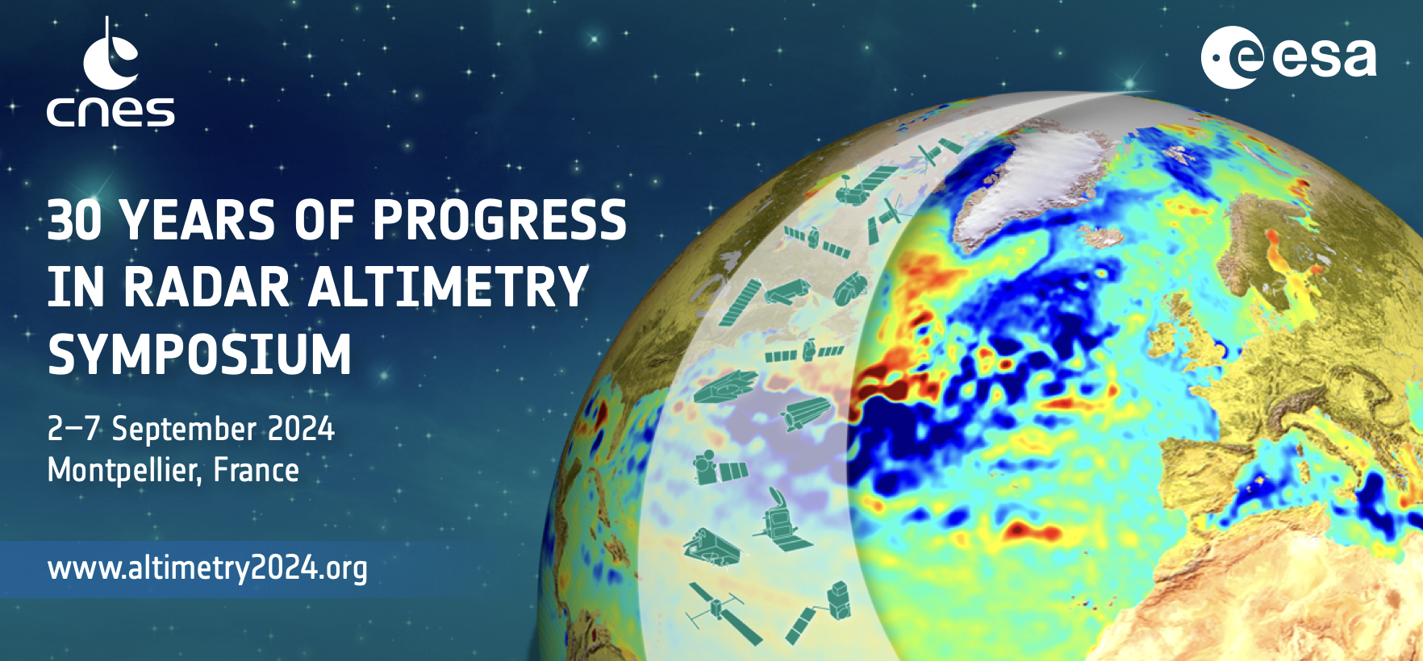
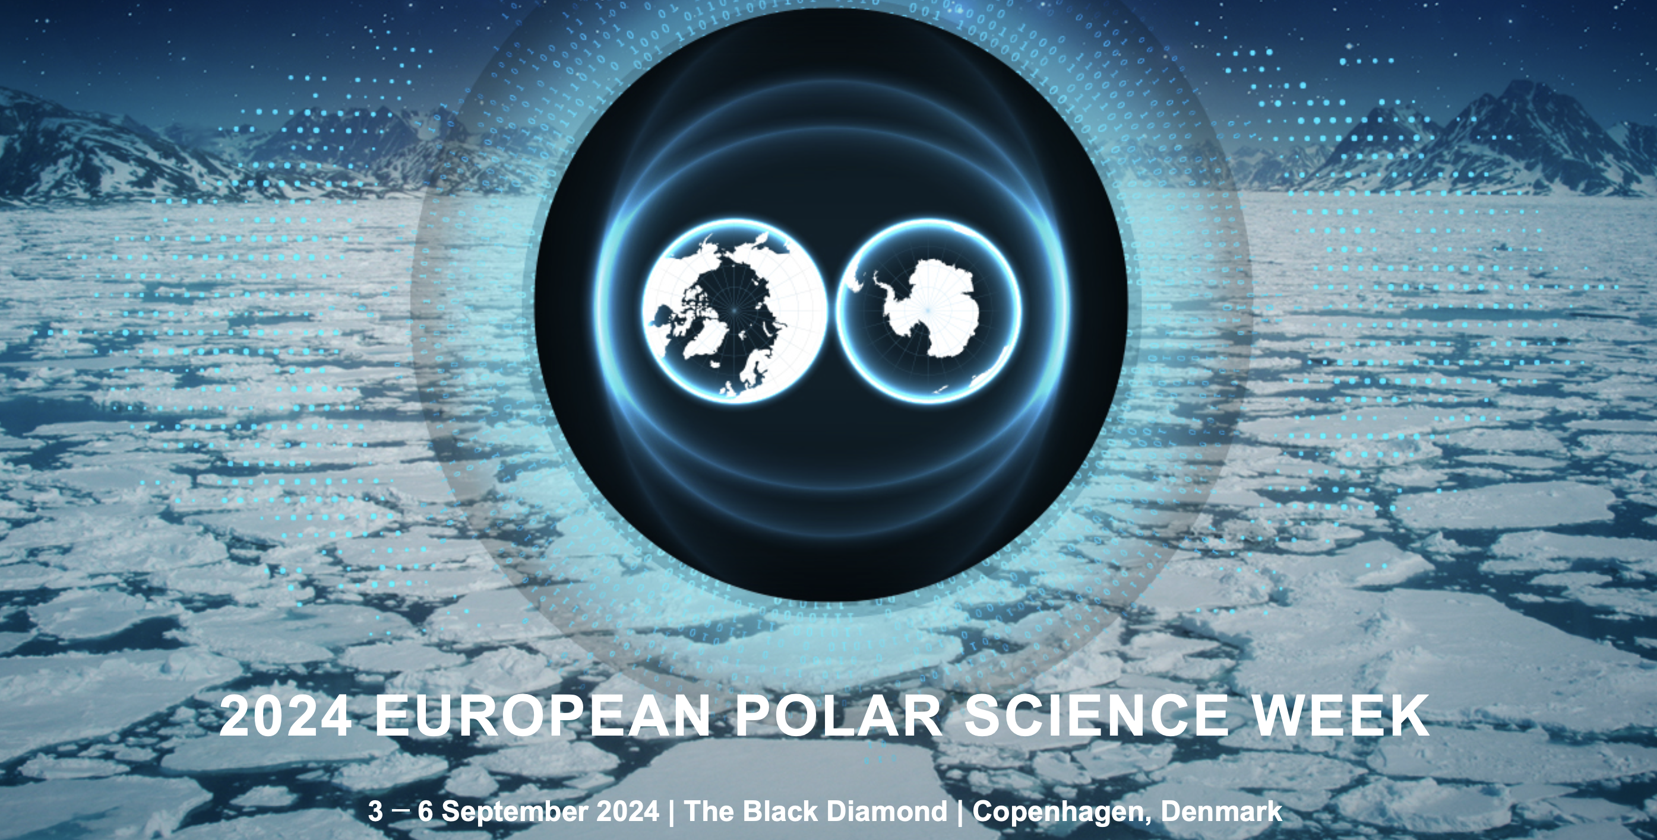
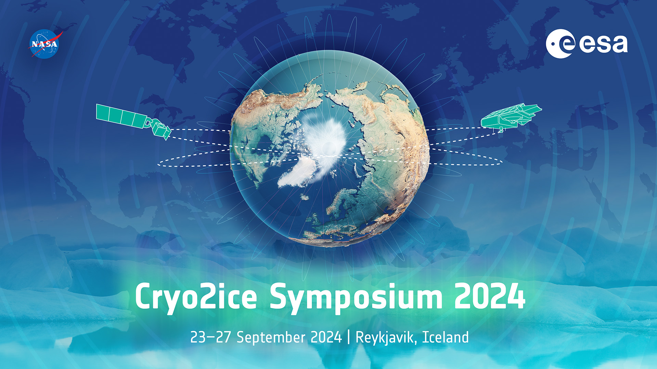
HIGHLIGTHS FROM THE SESSION
Session#7 on Cryosphere covering only the land ice domain while the the sea ice (also cryosphere !) was part of the session Polar Ocean.
7 posters and 9 exciting talks split in 2 sub-sessions on Monday 2 September
Good attendance of 70-100 persons despite being in parallel of the “2024 European Polar Science Week” (Copenhagen, Denmark) and just before the“Cryo2ice Symposium” (Reykjavik, Iceland)
Registration still open

Slide 3
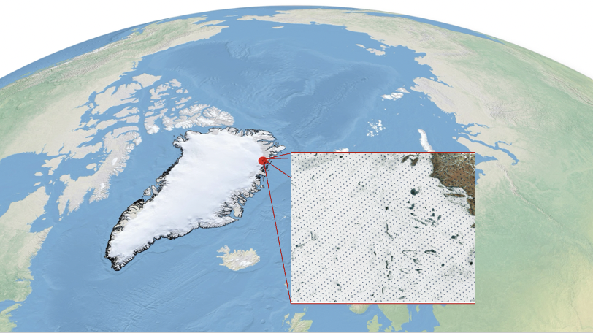
HIGHLIGTHS FROM THE PRESENTATIONS
Data driven L2 processing lines: Developments of AI models for improved interpretation of the radar waveforms, thereby circumventing 'retracking' (McMillan, Helm)

Slide 4
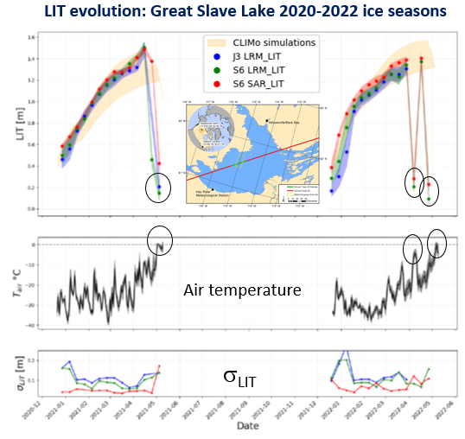
HIGHLIGTHS FROM THE PRESENTATIONS
Long-term records of lake ice thickness (LIT) can be generated from physical modelling of conventional radar returns. Significative improvement of the LIT estimation with high resolution data (UFSAR and FFSAR) (Mangilli)

Slide 5
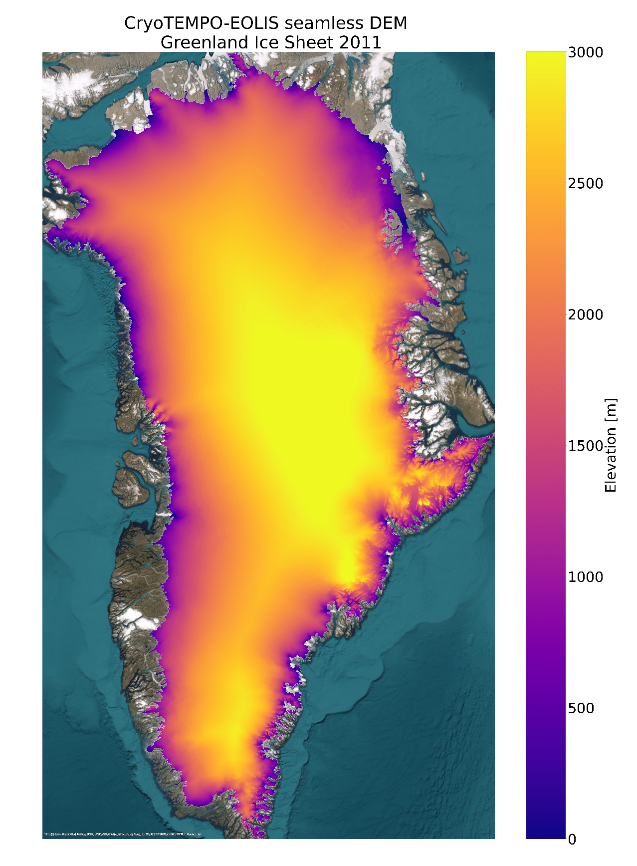
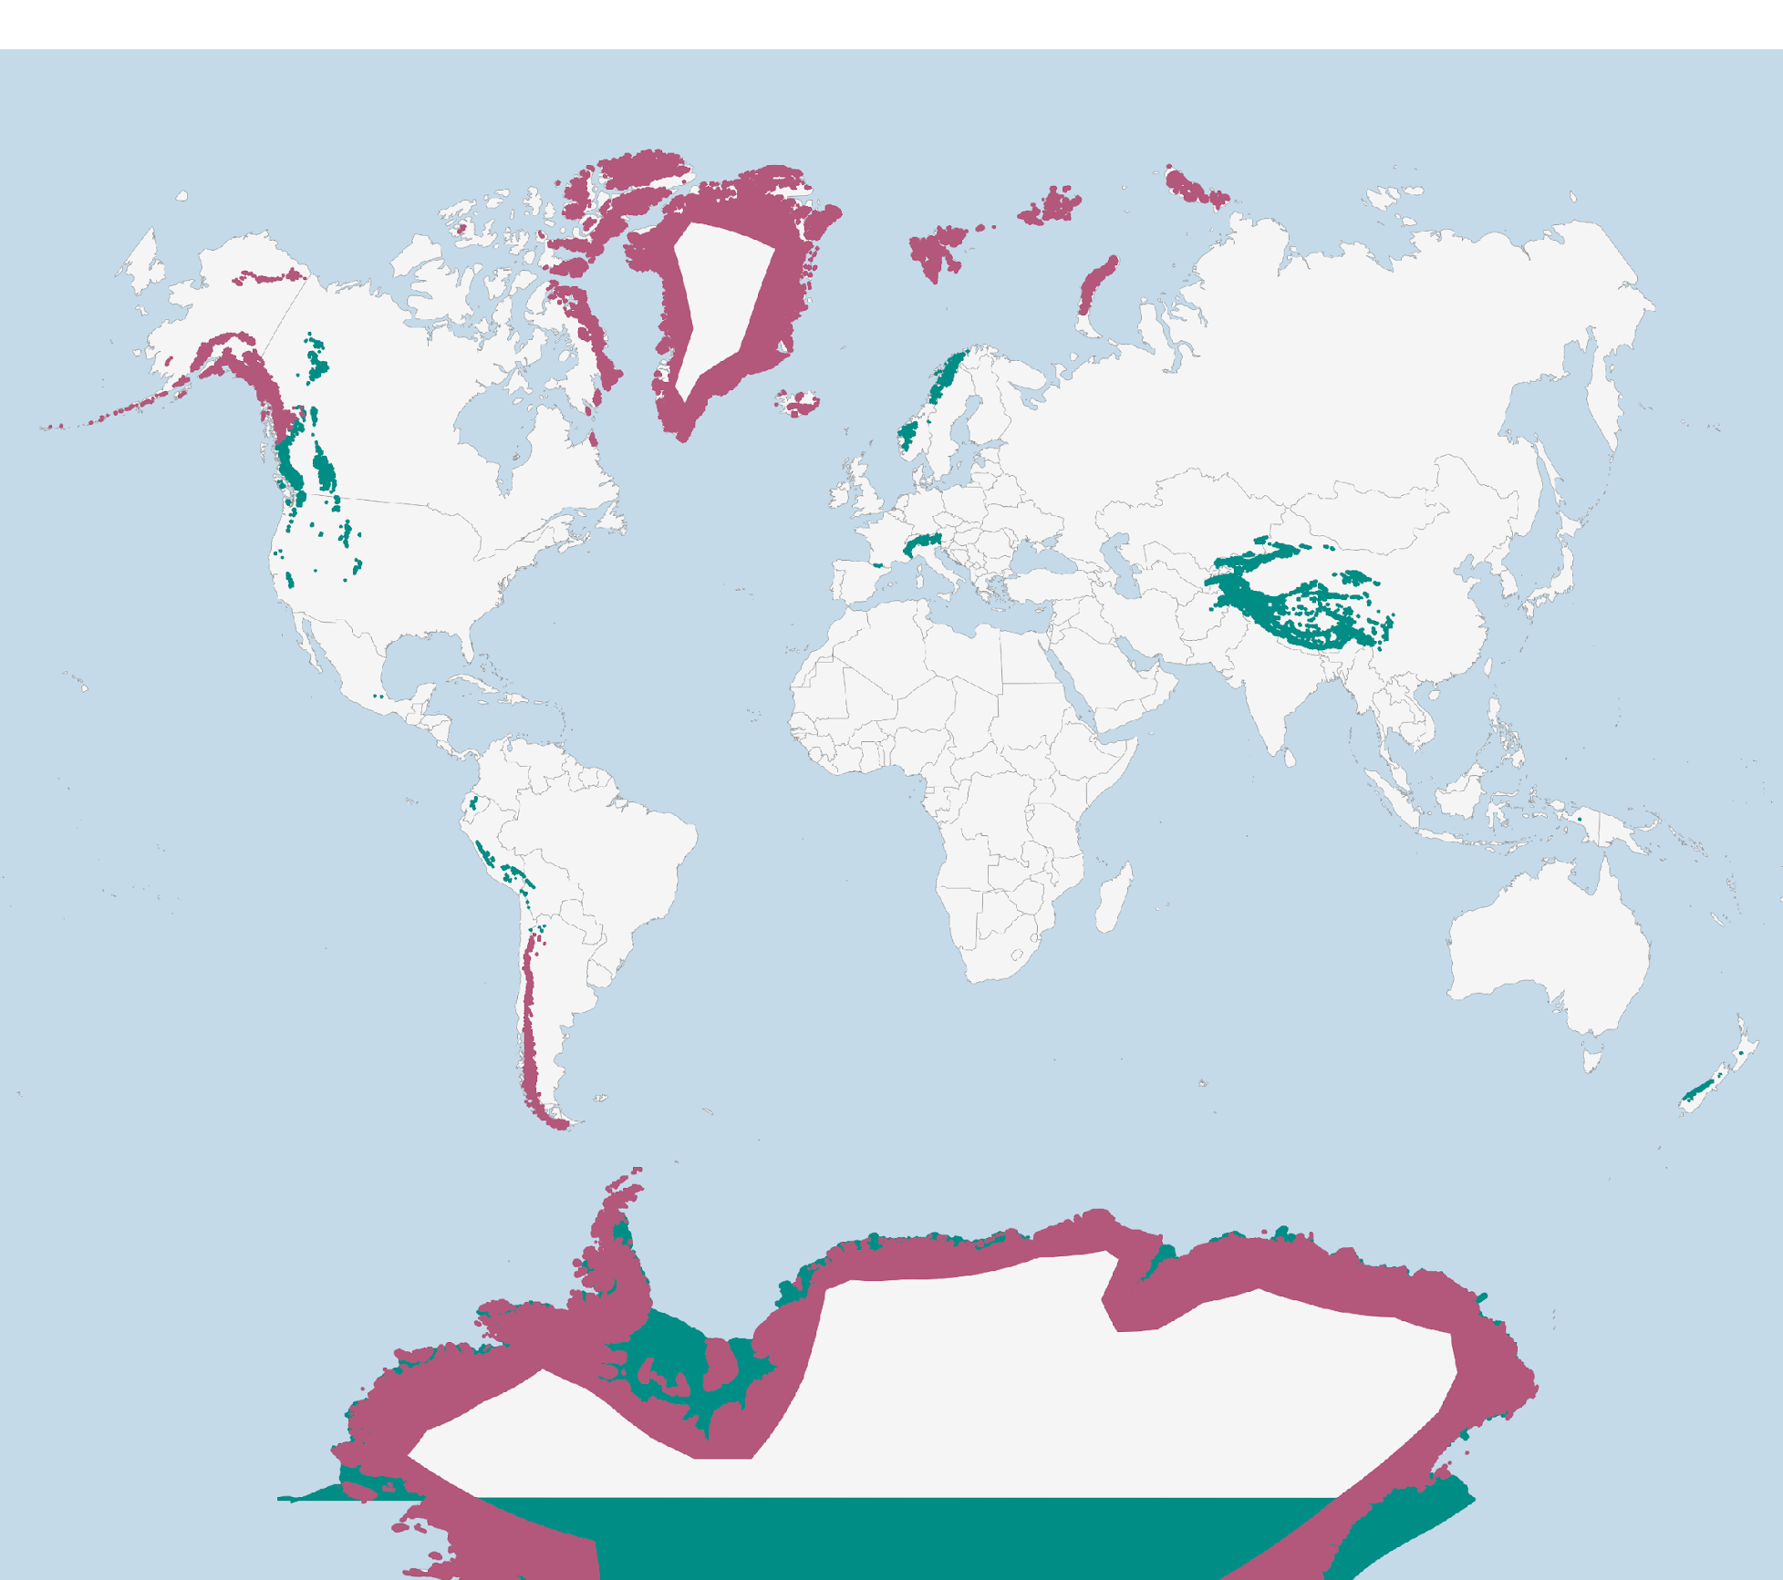
HIGHLIGTHS FROM THE PRESENTATIONS
Annual high-resolution DEMs for the ice sheets and new Glaciers products are/will soon be available (Winstrup, Incatasciato)
Seamless Annual Ice Sheet DEMs from EOLIS (release in 2025)

Slide 6
HIGHLIGTHS FROM THE PRESENTATIONS
The high potential of dual-frequency radars (e.g., CRISTAL); will better resolve outstanding questions of radar penetration depths into snow and firn (Borde, LeRoy)

Slide 7
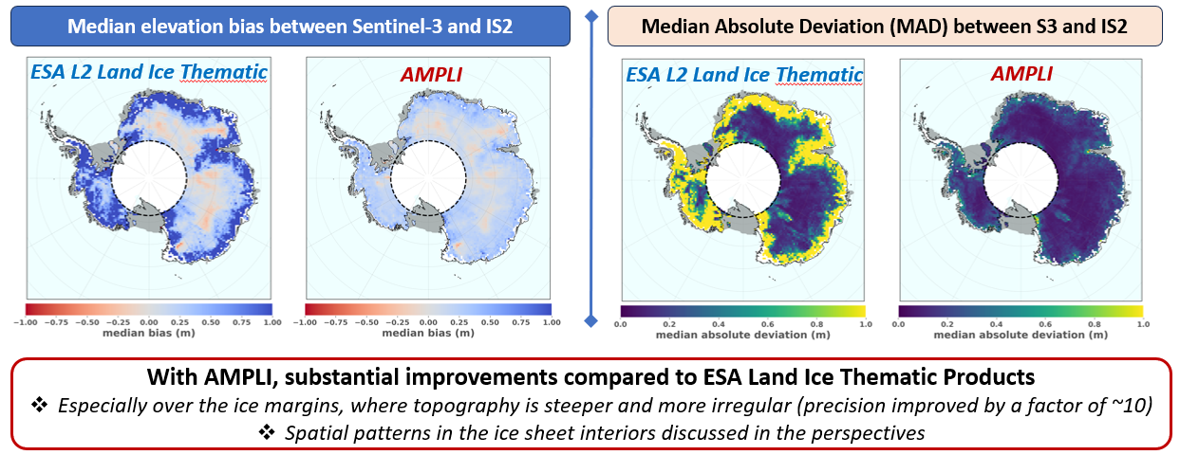
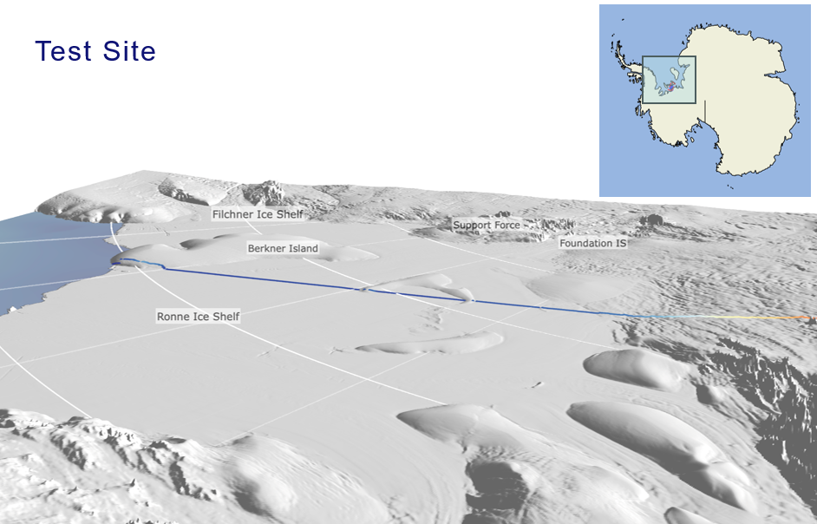
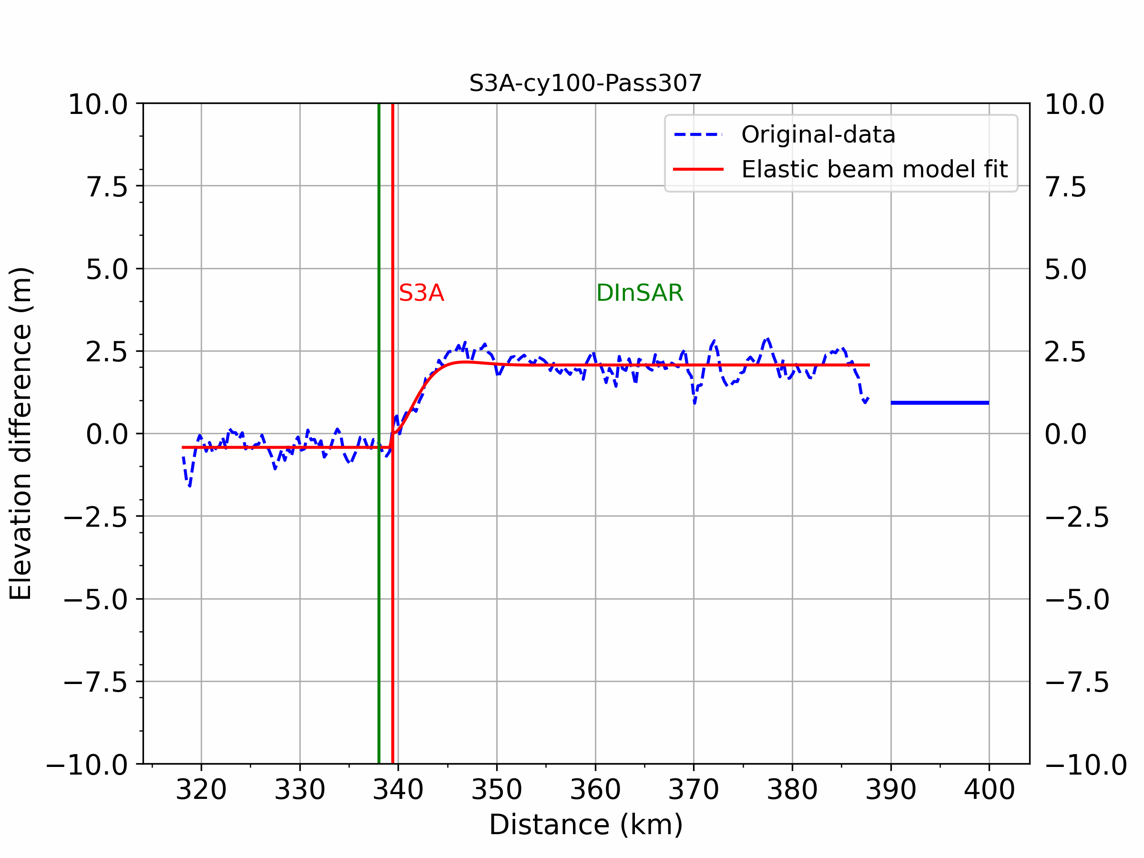
HIGLIGTHS FROM THE PRESENTATIONS
Potential for Sentinel-3 to become a mature and well-used tool for monitoring ice margins and coastal sectors of the cryosphere (Aublanc, Suryawanshi)
A facet-based numerical model to retrieve ice sheet topography from Sentinel-3 altimetry
Exploiting the potential of Sentinel 3 to detect Antarctic grounding line

Slide 8
RECOMMENDATIONS (1/2)
To keep CryoSat-2 in operation for sufficiently long to gain an extended overlap with CRISTAL; Allowing a gapless record as well as improved understanding of the current record
As the cryosphere is rapidly evolving, we recommend to enhance our ability to observe the cryosphere in higher spatial and temporal (monthly to seasonal) resolution – this can either be through satellite optimisation (e.g. orbits, instruments), or by investing in methodological advances (e.g. data assimilation)
Improving our knowledge of snow and firn penetration of the radar signals for improved mass balance assessments, also in expectation of CRISTAL
Accurate uncertainty estimates on the derived EO records are indispensable, and should be developed further

Slide 9
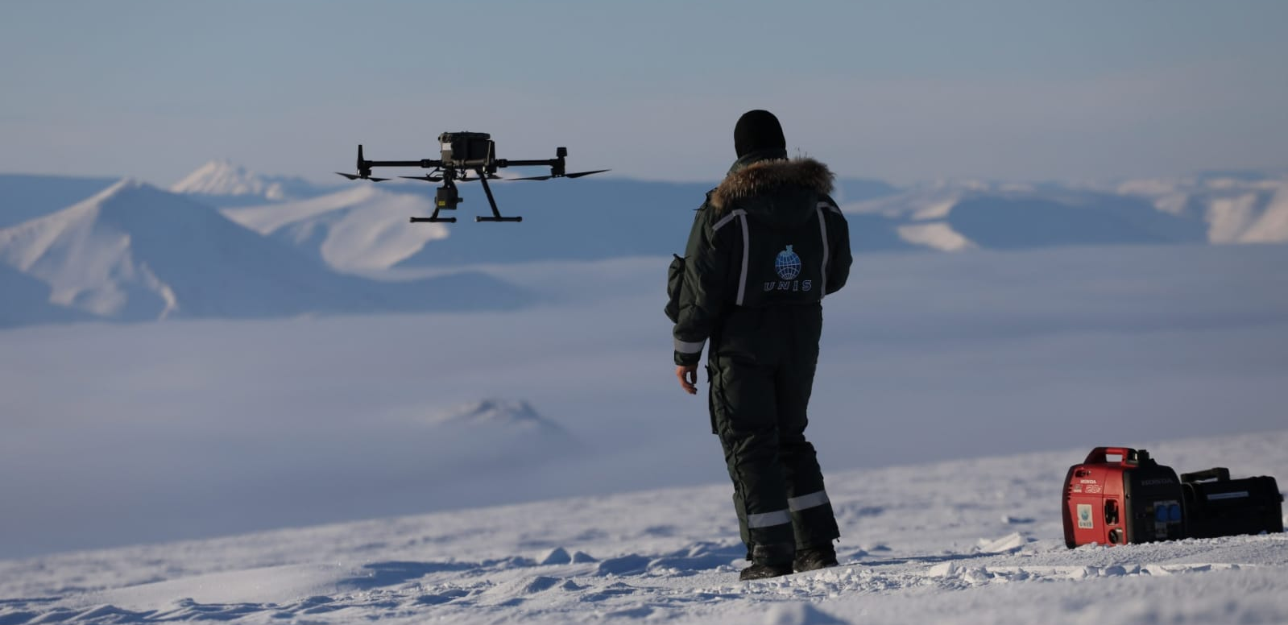
RECOMMENDATIONS (2/2)
Continuous collection of validation data (airborne, in situ) focused on the ice sheets (e.g. CryoVEX campaigns focused on land ice) are essential - moving to an operational era demands that this be planned and funded strategically (FRM, see Eero Rinne talk), and not ad hoc.
Improving our understanding of the physical processes driving mass loss; this also requires high-resolution, smaller-scale regional studies of the involved processes
Collaboration with climate modellers and investment in EO processing techniques for ice sheet data assimilation and multi-sensor synergies to ensure full gain of the observations (e.g. changes in ice sheet topography) when incorporated into climate models.
Continued investment in radar altimetry methodological innovation and R&D is essential to fully capitalise on their capability over the cryosphere.

